Slide 1
Accept the Modality Gap: An Exploration in the Hyperbolic Space
Thalaiyasingam Ajanthan
June 2024

Slide 2
Collaborators
Sameera Ramasinghe
Violetta Shevchenko
Gil Avraham
Thalaiyasingam Ajanthan

Slide 3
Motivation

Slide 4
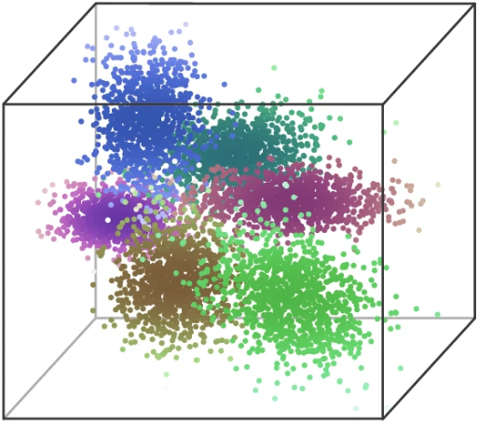
Representation Learning
Learn a structured latent space that is suitable for downstream tasks
Classification
Segmentation
Raw Data
Retrieval
Question Answering
…

Slide 5
Structure in the Latent Space
Desired properties
Semantically similar embeddings to be clustered together
Linear separability
Hierarchy preservation
…
Major factors that determine the latent structure
Latent space geometry (E.g., Euclidean, Spherical, Hyperbolic)
Loss function (E.g., Contrastive loss, metric-learning losses)
Data

Slide 6
Structure in the Latent Space
Usual learning paradigm
Spatial proximity based contrastive loss on the Hypersphere or the Euclidean space
Pulls matching datapoints closer while pushes non-matching ones apart
Problems
Euclidean space or Hypersphere is not ideal to encode hierarchical structures
Spatial proximity-based loss may disrupt hierarchies

Slide 7
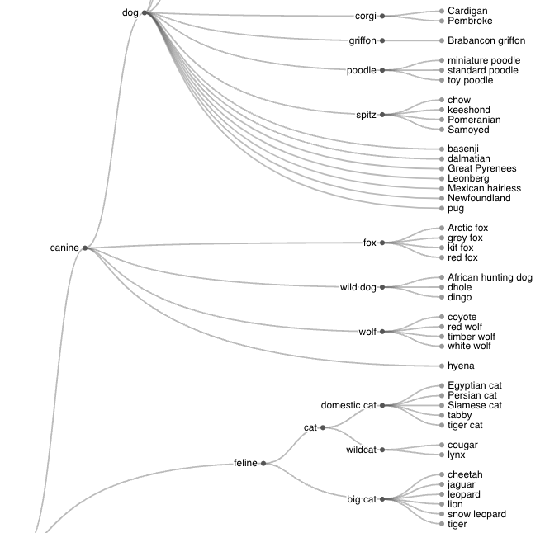
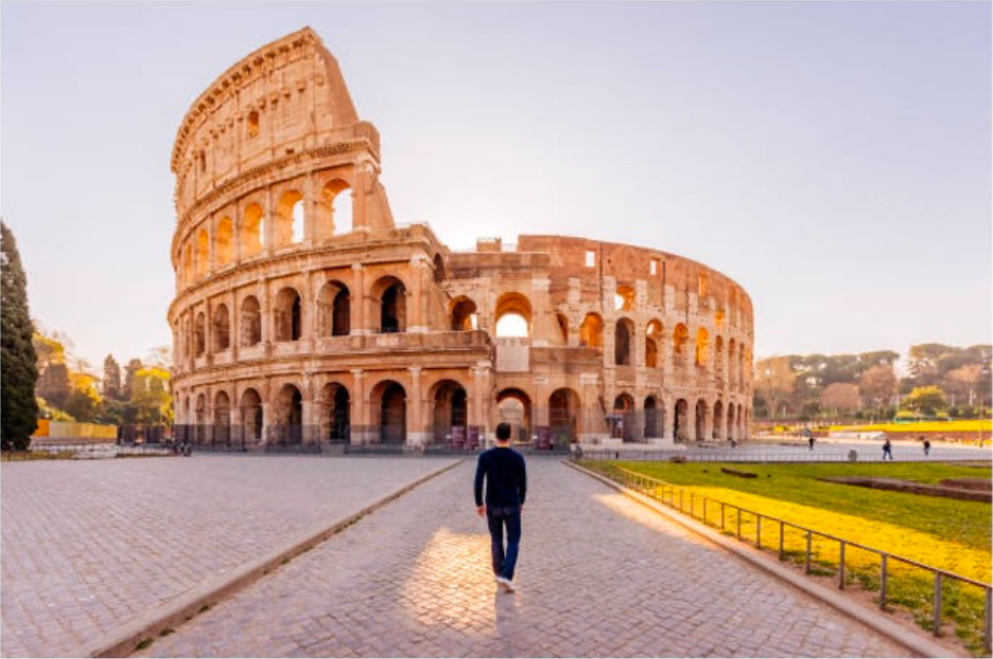
Why Hierarchy?
Real world is full of hierarchies
E.g., Hierarchy of species
Cross-modal hierarchy is crucial in multi-modal settings
E.g., Text is more generic than images
A photo of colosseum.
A photo of colosseum taken in the evening.
A photo of colosseum with a man in front.
A colosseum image with a person in a black cloth taken during sunset.
A solitary figure walks towards the grandeur of the Colosseum, a testament to ancient Rome's architectural prowess, under the soft glow of a setting sun.

Slide 8
CLIP Recap
Positive image and text pairs are clustered together while negatives are pushed apart
Similarity is measured using spatial proximity
CLIP representations still show misalignment – modality gap
https://github.com/openai/CLIP

Slide 9
Modality Gap
We argue modality gap is rooted in intrinsic differences between the modalities
E.g., Text is more generic than images
Spatial proximity-based alignment disrupts unimodal hierarchies
https://github.com/Weixin-Liang/Modality-Gap
https://openreview.net/pdf?id=KZut5N7waZ-

Slide 10
Background

Slide 11
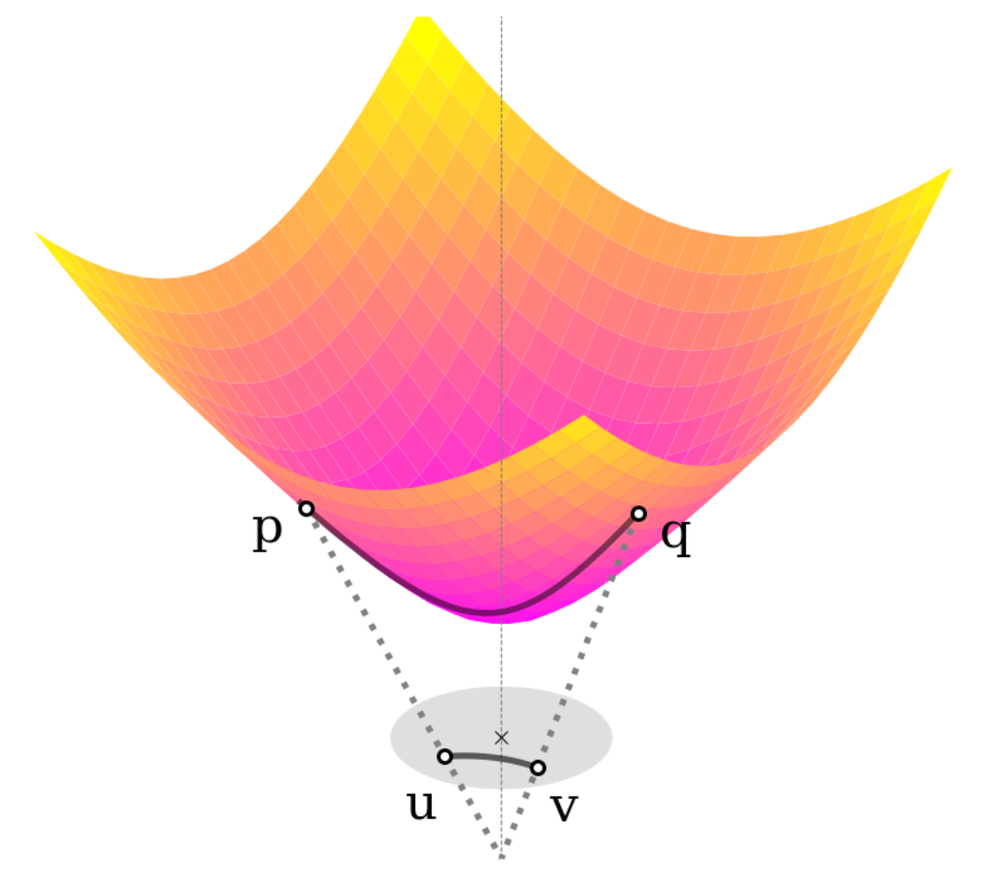
Hyperbolic Space
A Riemannian manifold with constant negative curvature
Exponential volume growth towards the boundary
Suitable for embedding hierarchical structures
https://proceedings.mlr.press/v80/nickel18a/nickel18a.pdf

Slide 12
Hyperbolic Space
Definitions
Hyperbolic space with curvature $c$:
Inner-product:
Time component:
Geodesic distance:
https://proceedings.mlr.press/v80/nickel18a/nickel18a.pdf

Slide 13
Existing Works on Hyperbolic Representations
Text only
Poincar$\acute{e}$ embeddings [Nickel-NeurIPS-2017]
Lorentz model [Nickel-ICML-2018]
Hyperbolic entailment cones [Ganea-ICML-2018]
Image only
Hyperbolic image embeddings [Khrulkov-CVPR-2020]
Hyperbolic vision transformers [Ermolov-CVPR-2022]
Image and Text
MERU [Desai-ICML-2023]

Slide 14
MERU: Hyperbolic Image-Text Representations
Adapting CLIP to the hyperbolic space
https://github.com/facebookresearch/meru

Slide 15
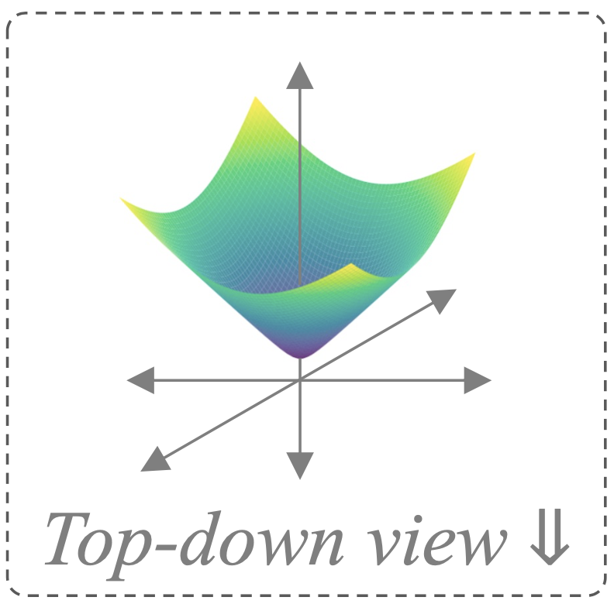
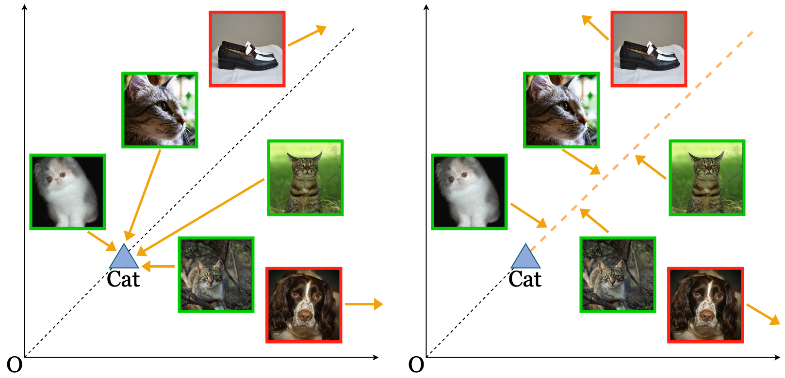
MERU: Contrastive Loss
Same as CLIP but with Hyperbolic distances
Clusters matching image-text pairs together
All images (texts) are treated equal, hence discourages unimodal hierarchies
Spatial proximity loss
https://github.com/facebookresearch/meru

Slide 16
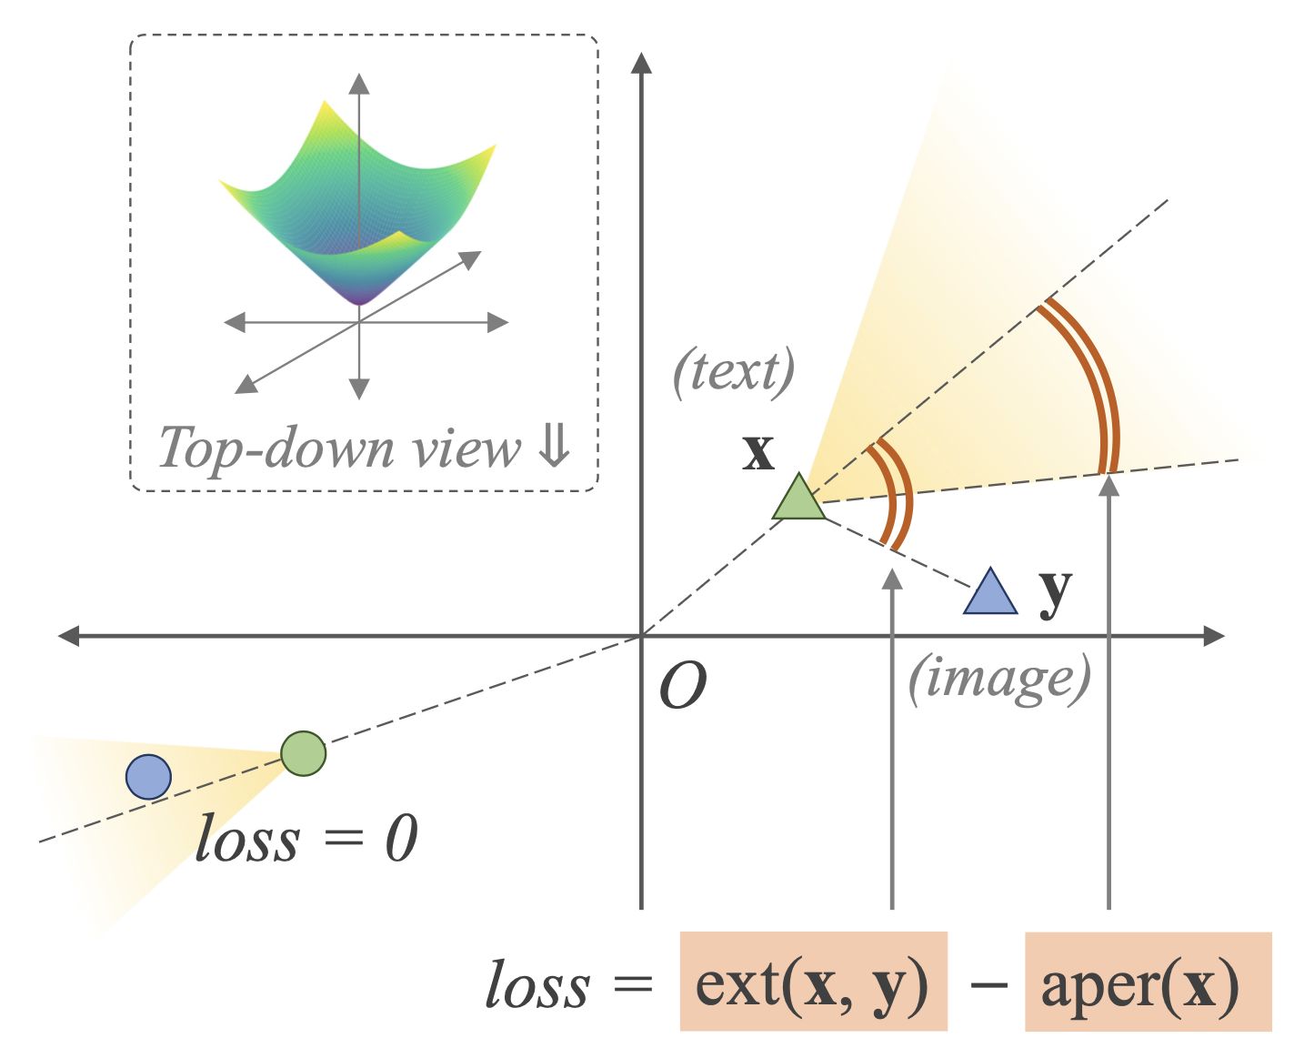
MERU: Entailment Loss
Encourages images to be within the cone emanating from the corresponding text embedding – text entails images
Issues
Discontinuous
Untrainable as a standalone loss
MERU used it as a regularization
Entailment loss cannot prevent embedding collapse
https://github.com/facebookresearch/meru

Slide 17
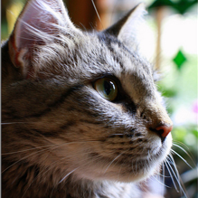
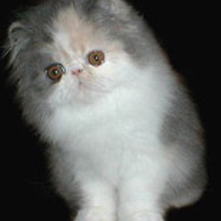
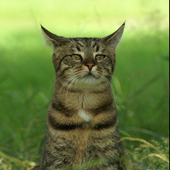
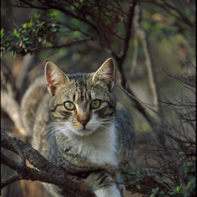
Interplay between the Losses
Spatial proximity-based contrastive loss prefers embedding collapse
If data encourages diverse embeddings, then entailment objective will be violated
To satisfy both the objectives, embeddings need to collapse
Cat
Cat
Cat
O
O
O
Combination of entailment and spatial proximity objectives disrupt hierarchies

Slide 18
Our Approach

Slide 19
Our Approach
Accept the modality gap!
Uses an alternative measure of similarity that respects the cross-modal hierarchy

Slide 20
Accept the Modality Gap
Spatial proximity loss
Our loss
Images can be placed anywhere along the axis, allows hierarchies

Slide 21
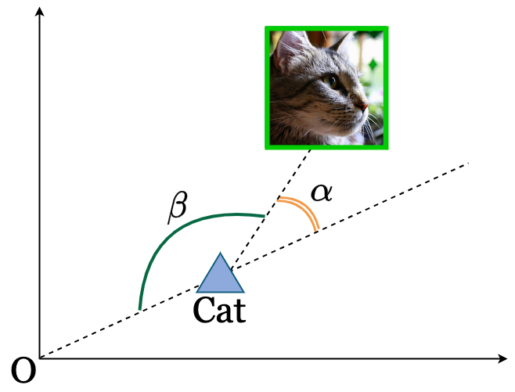
Angle-based Contrastive Loss
Similarity is measured using hyperbolic angles
Embedding norms are allowed to vary
Enforces cross-modal hierarchy: text is more generic than images
min($α$), max($β$)
Our Loss: Smooth, contrastive variant of entailment loss that accepts the modality gap

Slide 22
Angle-based Contrastive Loss
Calculations are straightforward
min($α$), max($β$)

Slide 23
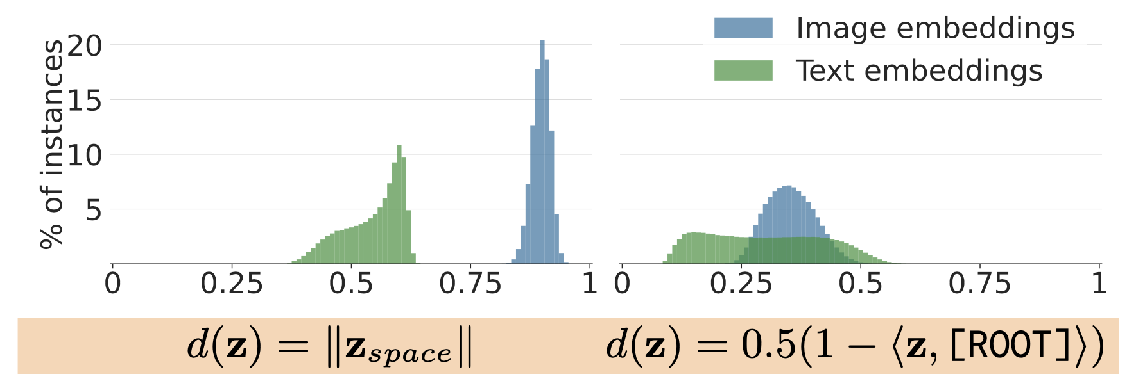
Cross-Modal Hierarchy
Ours
CLIP
Smaller norm (distance to the origin) means a more abstract concept

Slide 24
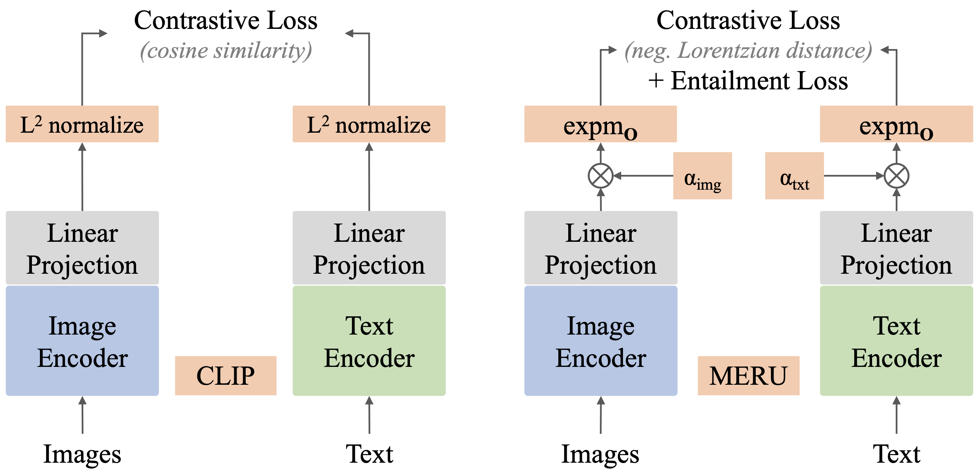
Model
(angle similarity)
OURS
Project embeddings to the hyperbolic space before computing the loss

Slide 25
Results

Slide 26
Zero-Shot Evaluation
Image classification
We show overall better performance compared to MERU and CLIP

Slide 27
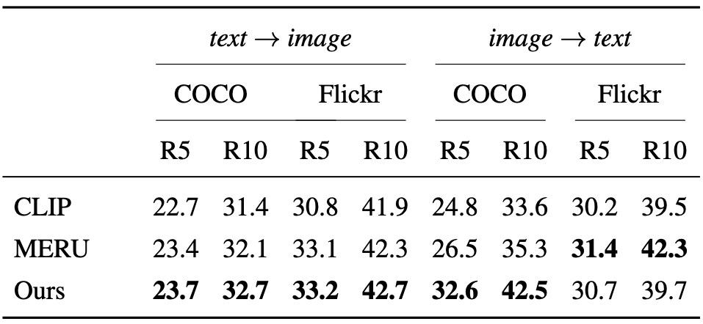
Zero-Shot Evaluation
Image and text retrieval
We outperform both MERU and CLIP, except on Flickr

Slide 28
Zero-Shot Evaluation
Image classification with varying curvature
MERU is sensitive to curvature and work well only on small curvatures – closer to Euclidean geometry
Our approach is consistent across varying curvatures

Slide 29
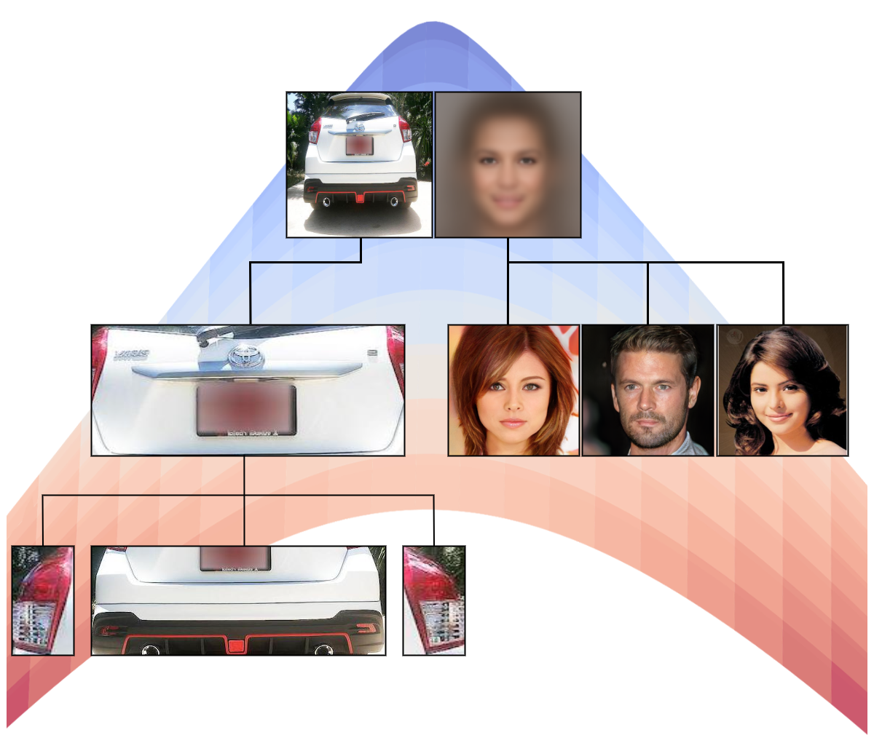
Image Hierarchy Results
Hierarchy can be quantified using the distance to the origin (i.e., norm): norm(parent) < norm(child)
Two types of image hierarchies emerge
“Contained in” hierarchy
“Abstract to specific” hierarchy

Slide 30
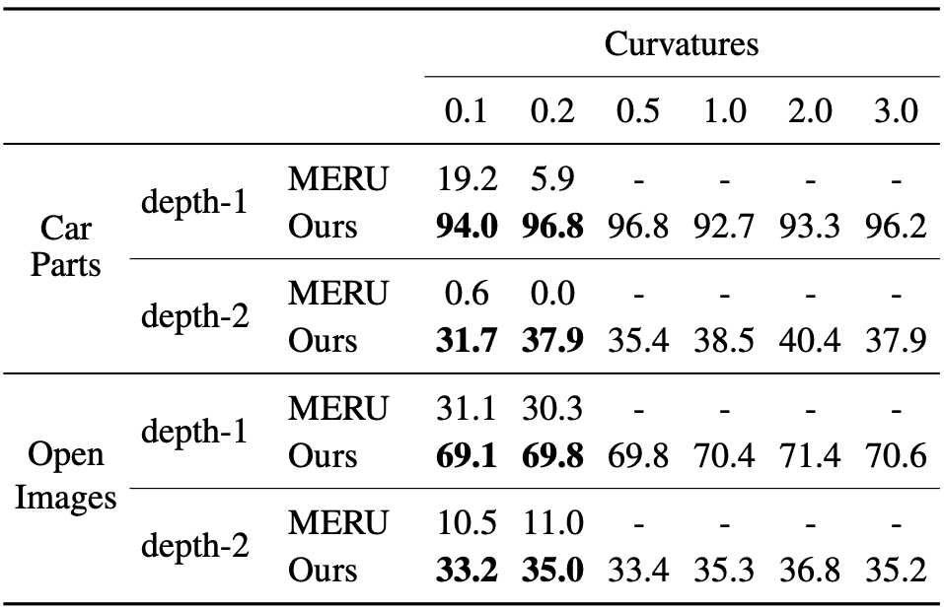
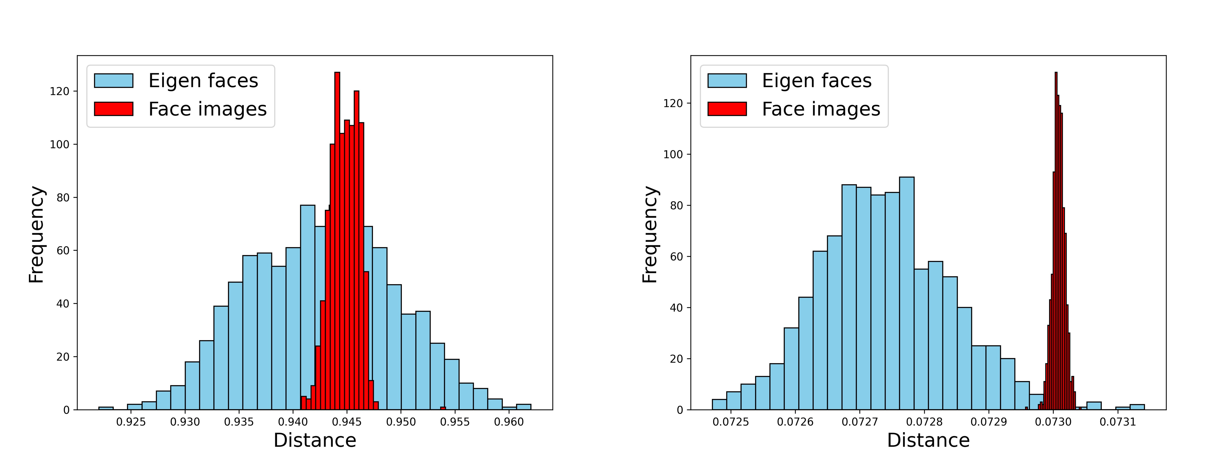
Image Hierarchy Results
MERU
Ours
“Contained in” image hierarchy
“Abstract to specific” image hierarchy
Better image hierarchies emerge for our method

Slide 31
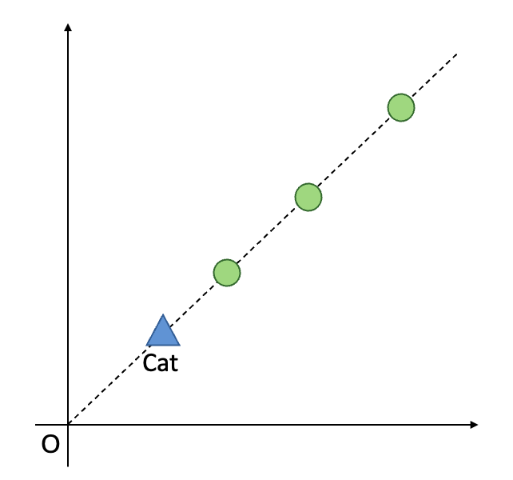
Image Traversal
Specificity (i.e., norm) increases from left to right
Norm can be used as an implicit uncertainty measure

Slide 32
Image Traversal
Specificity (i.e., norm) increases from left to right

Slide 33
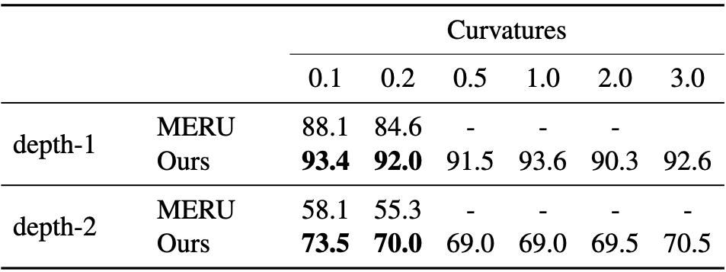
Text Hierarchy Results
adjectives
nouns
captions
“Generic to specific” caption hierarchy
Even for text, better hierarchies emerge for our method

Slide 34
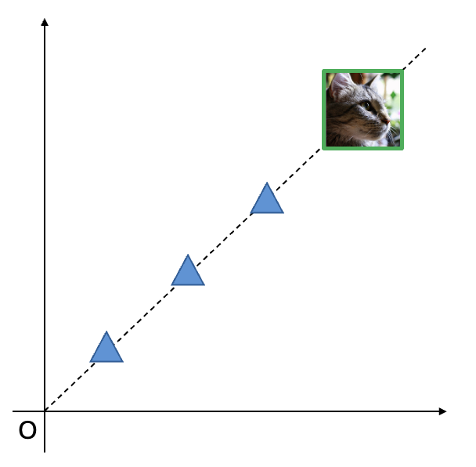
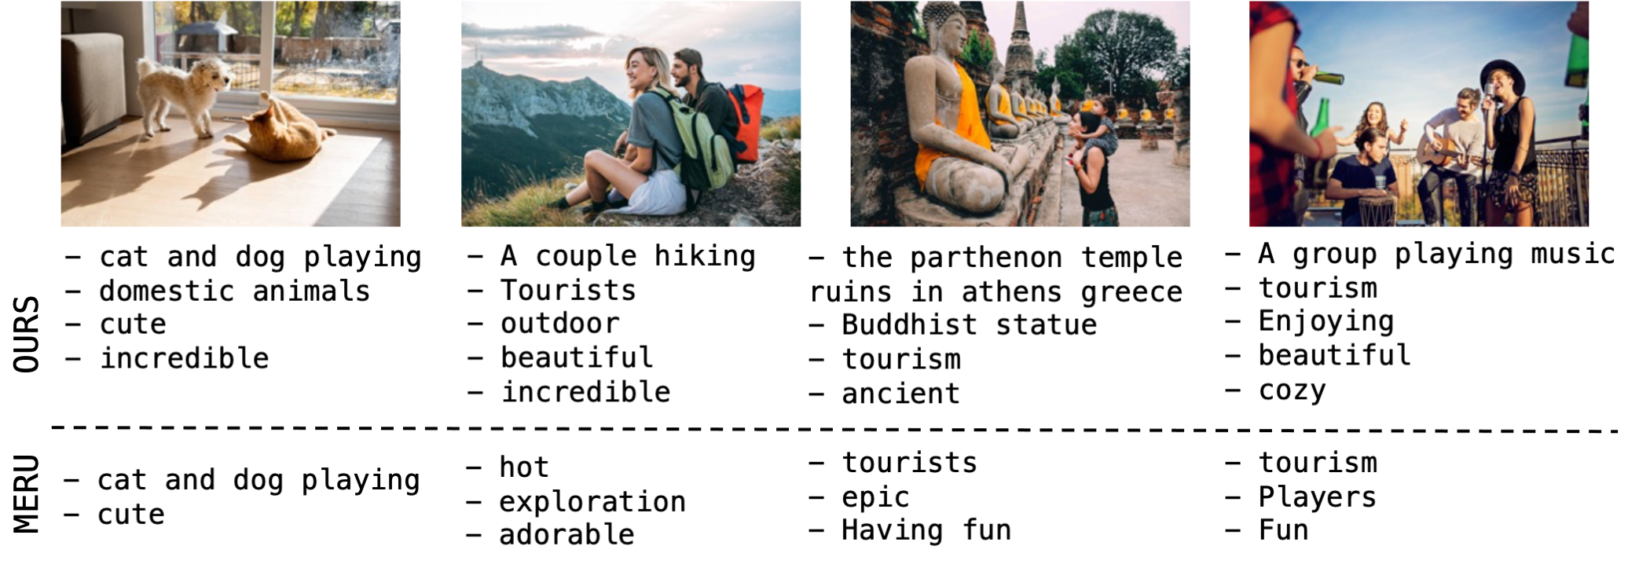
Text Traversal

Slide 35
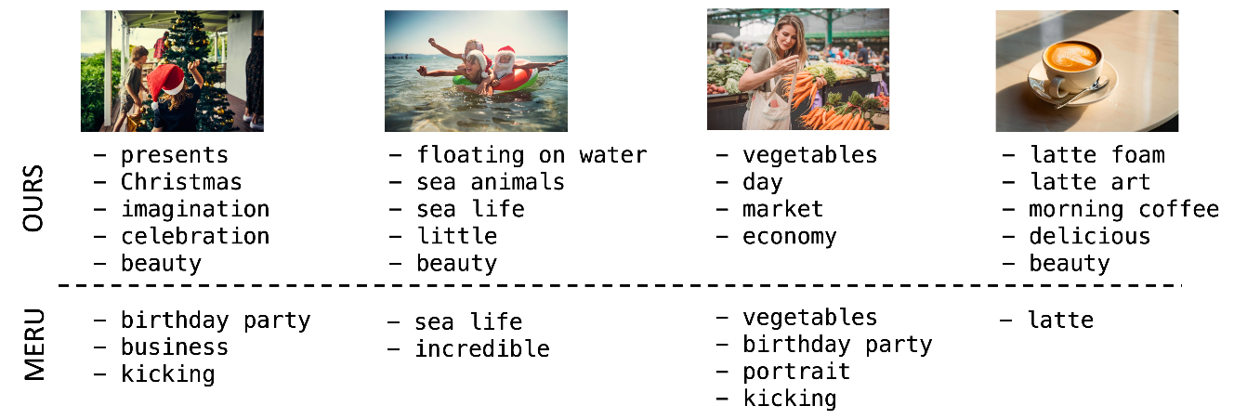
Text Traversal

Slide 36
Summary
Angle-based contrastive loss preserves unimodal hierarchies while aligning text and image modalities
https://www.amazon.science/publications/accept-the-modality-gap-an-exploration-in-the-hyperbolic-space

Slide 37
Next Steps
Enforce unimodal hierarchies, rather than showing emergent behavior
Analyze the implications of accepting the modality gap

Slide 38
Questions?

Slide 39
Thank You

